Slide 1
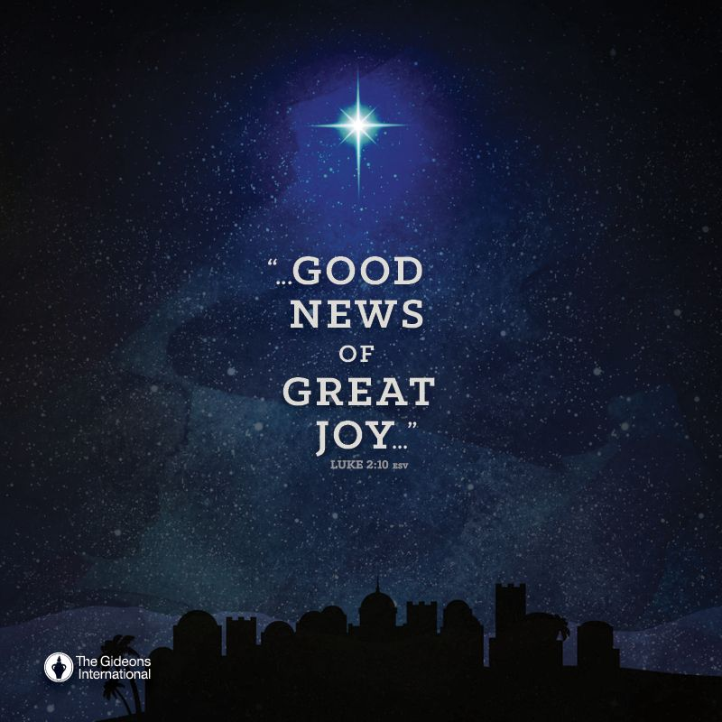
Luke 2:15-20

Slide 2
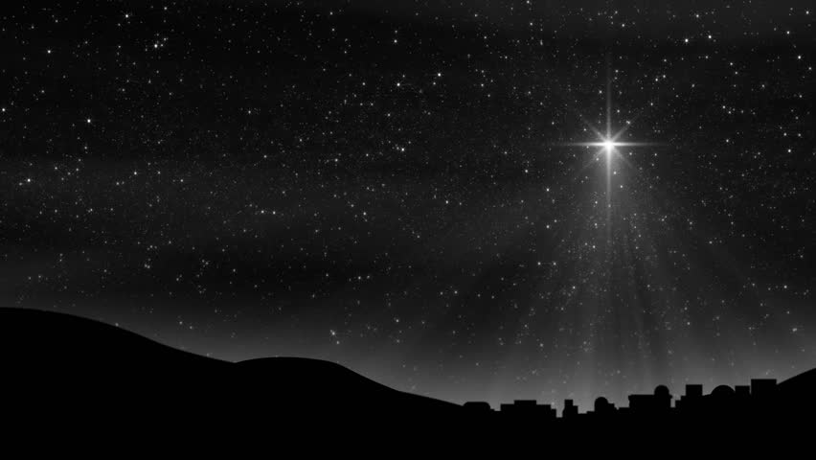
“The wonder of the gospel!”
“By him all things were created, in heaven and on earth.” (Colossians 1:16)
He is the One who “upholds the universe by the word of his power.” (Hebrews 1:3)

Slide 3
I. Faith takes God at His word and acts accordingly (verses 15-16)
15 When the angels went away from them into heaven, the shepherds said to one another, “Let us go over to Bethlehem and see this thing that has happened, which the Lord has made known to us.” 16 And they went with haste and found Mary and Joseph, and the baby lying in a manger.
12 And this will be a sign for you: you will find a baby wrapped in swaddling cloths and lying in a manger.”

Slide 4
II. The joy of Christmas is found in a right response to the gospel (verses 17-19)
To those who believe, the right response is to share it (verse 17)
17 And when they saw it, they made known the saying that had been told them concerning this child.
“Therefore, if anyone is in Christ, he is a new creation. The old has passed away; behold, the new has come.” 2 Corinthians 5:17

Slide 5
II. The joy of Christmas is found in a right response to the gospel (verses 17-19)
To those who believe, the right response is to share it (verse 17)
To those who are hearing it, the right response is to carefully consider and embrace it (verses 18-19)
18 And all who heard it wondered at what the shepherds told them.

Slide 6
“Wonder” is usually accompanied by a lack of understanding in Luke’s writing
“As they were talking about these things, Jesus himself stood among them, and said to them, ‘Peace to you!’ But they were startled and frightened and thought they saw a spirit. And he said to them, ‘Why are you troubled, and why do doubts arise in your hearts? See my hands and my feet, that it is I myself. Touch me, and see. For a spirit does not have flesh and bones as you see that I have.’ And when he had said this, he showed them his hands and his feet. And while they still disbelieved for joy and were marveling, he said to them, ‘Have you anything here to eat?’” Luke 24:36-41

Slide 7
II. The joy of Christmas is found in a right response to the gospel (verses 17-19)
To those who believe, the right response is to share it (verse 17)
To those who are hearing it, the right response is to carefully consider and embrace it (verses 18-19)
18 And all who heard it wondered at what the shepherds told them.
“And while they still disbelieved for joy and were marveling, he said to them, ‘Have you anything here to eat?’” Luke 24:41
“to be extraordinarily impressed or disturbed by something”

Slide 8
II. The joy of Christmas is found in a right response to the gospel (verses 17-19)
To those who believe, the right response is to share it (verse 17)
To those who are hearing it, the right response is to carefully consider and embrace it (verses 18-19)
18 And all who heard it wondered at what the shepherds told them.
“Beware, therefore, lest what is said in the Prophets should come about: ‘Look, you scoffers, be astounded and perish; for I am doing a work in your days, a work that you will not believe, even if one tells it to you.’” Acts 13:40-41

Slide 9
II. The joy of Christmas is found in a right response to the gospel (verses 17-19)
To those who believe, the right response is to share it (verse 17)
To those who are hearing it, the right response is to carefully consider and embrace it (verses 18-19)
18 And all who heard it wondered at what the shepherds told them.
19 But Mary treasured up all these things, pondering them in her heart.

Slide 10
III. Christmas is a time of great joy because of the wonder of the gospel! (verse 20)
20 And the shepherds returned, glorifying and praising God for all they had heard and seen, as it had been told them.
“You need to get lost in the wonder of God. If you'll get lost in that wonder, who knows what he'll do for you.”

Slide 11
“The wonder of the gospel!”
Ephesians 2
“you were dead in the trespasses and sins,” (1) “carrying out the desires of the body and the mind, and were by nature children of wrath, like the rest of mankind” (3). “But God, being rich in mercy, because of the great love with which he loved us, even when we were dead in our trespasses, made us alive together with Christ” (4-5) “so that in the coming ages he might show the immeasurable riches of his grace in kindness toward us in Christ Jesus. For by grace you have been saved through faith. And this is not your own doing; it is the gift of God” (7-8).

