Slide 1
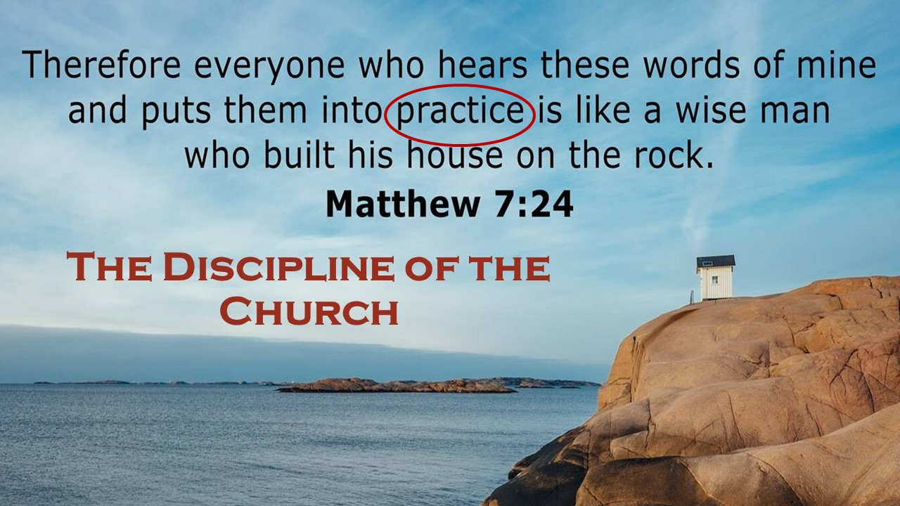

Slide 2
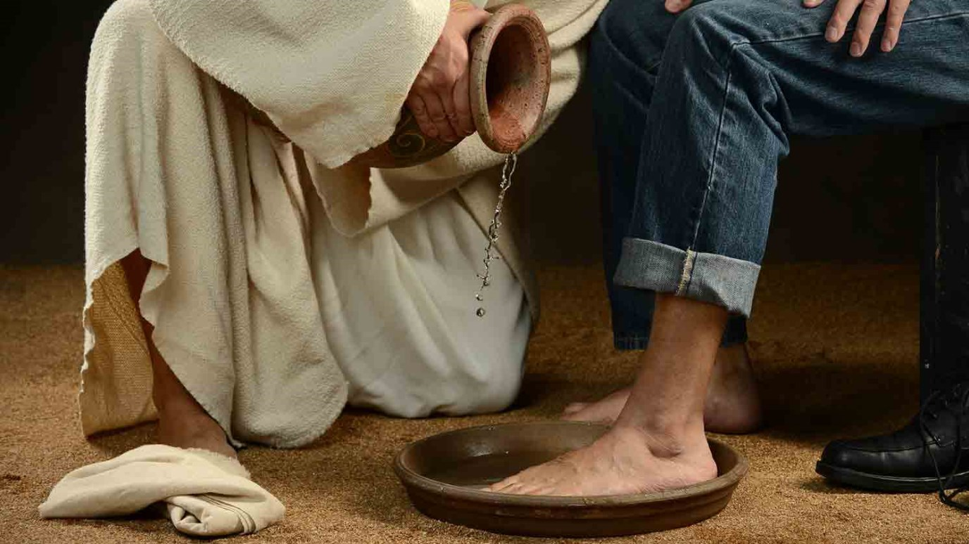
Be a servant of Christ
Romans 1:1-17

Slide 3
“Do you understand what I have done to you? You call me Teacher and Lord, and you are right, for so I am. If I then, your Lord and Teacher, have washed your feet, you also ought to wash one another’s feet. For I have given you an example, that you also should do just as I have done to you. Truly, truly, I say to you, a servant is not greater than his master, nor is a messenger greater than the one who sent him. If you know these things, blessed are you if you do them.” John 13:12-17

Slide 4
I. The signature quality of a servant of Christ is obedience
“Therefore go and make disciples of all nations…teaching them to obey everything I have commanded you.” Matthew 28:19-20, NIV
“…whoever does not obey the Son shall not see life, but the wrath of God remains on him.” John 3:36

Slide 5
I. The signature quality of a servant of Christ is obedience
An obedient servant of Christ is not ashamed of the gospel (16-17, NLT)
What would make us ashamed of the gospel?
“…whoever does not obey the Son shall not see life, but the wrath of God remains on him.” John 3:36
“…whoever does not believe is condemned already” John 3:18
Later in John 5:29, two very different resurrections: “those who have done good to the resurrection of life, and those who have done evil to the resurrection of judgment.”

Slide 6
I. The signature quality of a servant of Christ is obedience
An obedient servant of Christ is not ashamed of the gospel (16-17, NLT)
16 For I am not ashamed of this Good News about Christ. It is the power of God at work, saving everyone who believes—the Jew first and also the Gentile. 17 This Good News tells us how God makes us right in his sight. This is accomplished from start to finish by faith. As the Scriptures say, “It is through faith that a righteous person has life.”

Slide 7
I. The signature quality of a servant of Christ is obedience
An obedient servant of Christ is not ashamed of the gospel (16-17, NLT)
16 For I am not ashamed of this Good News about Christ. It is the power of God at work, saving everyone who believes—the Jew first and also the Gentile. 17 This Good News tells us how God makes us right in his sight. This is accomplished from start to finish by faith. As the Scriptures say, “It is through faith that a righteous person has life.”

Slide 8
I. The signature quality of a servant of Christ is obedience
An obedient servant of Christ heeds His calling (1-7)
1 Paul, a servant of Christ Jesus, called to be an apostle, set apart for the gospel of God, 2 which he promised beforehand through his prophets in the holy Scriptures, 3 concerning his Son, who was descended from David according to the flesh 4 and was declared to be the Son of God in power according to the Spirit of holiness by his resurrection from the dead, Jesus Christ our Lord, 5 through whom we have received grace and apostleship to bring about the obedience of faith for the sake of his name among all the nations, 6 including you who are called to belong to Jesus Christ…

Slide 9
I. The signature quality of a servant of Christ is obedience
An obedient servant of Christ heeds His calling (1-7)
1 Paul, a servant of Christ Jesus, called to be an apostle, set apart for the gospel of God, 2 which he promised beforehand through his prophets in the holy Scriptures, 3 concerning his Son, who was descended from David according to the flesh 4 and was declared to be the Son of God in power according to the Spirit of holiness by his resurrection from the dead, Jesus Christ our Lord, 5 through whom we have received grace and apostleship to bring about the obedience of faith for the sake of his name among all the nations, 6 including you who are called to belong to Jesus Christ…

Slide 10
I. The signature quality of a servant of Christ is obedience
An obedient servant of Christ heeds His calling (1-7)
1 Paul, a servant of Christ Jesus, called to be an apostle, set apart for the gospel of God, 2 which he promised beforehand through his prophets in the holy Scriptures, 3 concerning his Son, who was descended from David according to the flesh 4 and was declared to be the Son of God in power according to the Spirit of holiness by his resurrection from the dead, Jesus Christ our Lord, 5 through whom we have received grace and apostleship to bring about the obedience of faith for the sake of his name among all the nations, 6 including you who are called to belong to Jesus Christ…

Slide 11
I. The signature quality of a servant of Christ is obedience
An obedient servant of Christ accomplishes the work of ministry (1-7)
1 Paul, a servant of Christ Jesus, called to be an apostle, set apart for the gospel of God, 2 which he promised beforehand through his prophets in the holy Scriptures, 3 concerning his Son, who was descended from David according to the flesh 4 and was declared to be the Son of God in power according to the Spirit of holiness by his resurrection from the dead, Jesus Christ our Lord, 5 through whom we have received grace and apostleship to bring about the obedience of faith for the sake of his name among all the nations…

Slide 12
I. The signature quality of a servant of Christ is obedience
An obedient servant of Christ accomplishes the work of ministry (1-7)
5 …to bring about the obedience of faith…
“In Christ Jesus, then, I have reason to be proud of my work for God. For I will not venture to speak of anything except what Christ has accomplished through me to bring the Gentiles to obedience—by word and deed, by the power of signs and wonders, by the power of the Spirit of God—so that from Jerusalem and all the way around to Illyricum I have fulfilled the ministry of the gospel of Christ.” Romans 15:17-19

Slide 13
I. The signature quality of a servant of Christ is obedience
An obedient servant of Christ prays for the faithfulness of the church (8-10)
8 First, I thank my God through Jesus Christ for all of you, because your faith is proclaimed in all the world. 9 For God is my witness, whom I serve with my spirit in the gospel of his Son, that without ceasing I mention you 10 always in my prayers…

Slide 14
I. The signature quality of a servant of Christ is obedience
An obedient servant of Christ longs to build one another up (10-13)
10 always in my prayers, asking that somehow by God’s will I may now at last succeed in coming to you. 11 For I long to see you, that I may impart to you some spiritual gift to strengthen you— 12 that is, that we may be mutually encouraged by each other’s faith, both yours and mine.
13 I want to work among you and see spiritual fruit. NLT

Slide 15
I. The signature quality of a servant of Christ is obedience
An obedient servant of Christ is burdened with an obligation to Christ’s calling (14-15)
14 I am under obligation both to Greeks and to barbarians, both to the wise and to the foolish. 15 So I am eager to preach the gospel to you also who are in Rome.

Slide 16
I. The signature quality of a servant of Christ is obedience
An obedient servant of Christ is burdened with an obligation to Christ’s calling (14-15)
14 I am under obligation…
“What do you think? A man had two sons. And he went to the first and said, ‘Son, go and work in the vineyard today.’ And he answered, ‘I will not,’ but afterward he changed his mind and went. And he went to the other son and said the same. And he answered, ‘I go, sir,’ but did not go. Which of the two did the will of his father?” They said, “The first.” Matthew 21:28-31

Slide 17
II. Be a servant of christ
Be a servant by living and sharing the gospel boldly
“For whoever is ashamed of me and of my words, of him will the Son of Man be ashamed when he comes in his glory.” Luke 9:26
Heed His calling in your life
Serve Him in ministry knowing He gives you every grace you need to serve Him well
Be a person devoted to prayer
“The prayer of a righteous person has great power as it is working.” James 5:16

Slide 18
II. Be a servant of Christ
Remember that our Lord gave us one another to help us live the life of obedience He calls us to
“…equip the saints for the work of ministry, for building up the body of Christ, until we all attain to the unity of the faith and of the knowledge of the Son of God, to mature manhood, to the measure of the stature of the fullness of Christ…” Ephesians 4:12-13

Slide 19
II. Be a servant of Christ
Serve with a sense of obligation
“Watch and pray that you may not enter into temptation. The spirit indeed is willing, but the flesh is weak.” Matthew 26:41
Obligation for a servant of Christ is the determination to seek His grace to do what we should when our flesh is tempting us to do what we want instead.

