Slide 2
Be the Lord’s Humble Servant
Luke 1:26-38

Slide 3
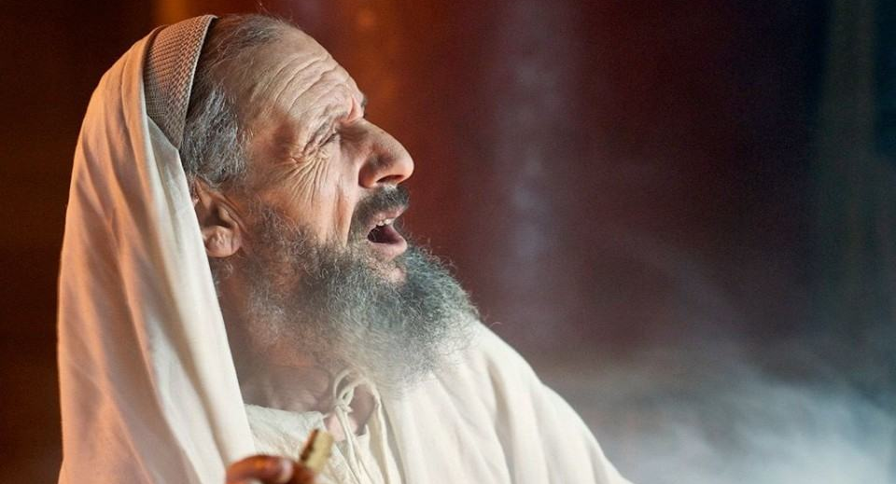
I. God sent the great angel Gabriel to a young girl named Mary (verses 26-27)
“Your wife Elizabeth will bear you a son, and you shall call his name John.”
“He will turn many of the children of Israel to the Lord their God.”
“He will go before him in the spirit and power of Elijah, to turn the hearts of the fathers to the children…”

Slide 4
I. God sent the great angel Gabriel to a young girl named Mary (verses 26-27)
26 In the sixth month the angel Gabriel was sent from God to a city of Galilee named Nazareth,
27 to a virgin betrothed to a man whose name was Joseph, of the house of David. And the virgin’s name was Mary.

Slide 5
II. Mary was blessed by God to give birth to Jesus (verses 28-33)
28 And he came to her and said, “Greetings, O favored one, the Lord is with you!” 29 But she was greatly troubled at the saying, and tried to discern what sort of greeting this might be. 30 And the angel said to her, “Do not be afraid, Mary, for you have found favor with God.
29 …confused and disturbed (NLT)

Slide 6
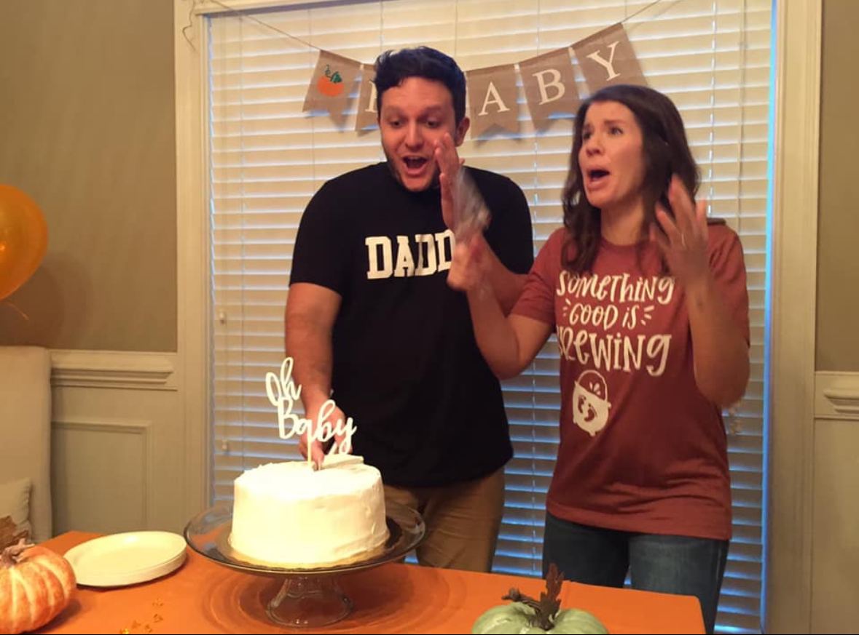

Slide 7
II. Mary was blessed by God to give birth to Jesus (verses 28-33)
31 And behold, you will conceive in your womb and bear a son, and you shall call his name Jesus. 32 He will be great and will be called the Son of the Most High. And the Lord God will give to him the throne of his father David, 33 and he will reign over the house of Jacob forever, and of his kingdom there will be no end.”

Slide 8
III. Despite being confused and disturbed, Mary trusted God and His word (verses 34-38)
34 And Mary said to the angel, “How will this be, since I am a virgin?”
35 And the angel answered her, “The Holy Spirit will come upon you, and the power of the Most High will overshadow you; therefore the child to be born will be called holy—the Son of God.
“Great indeed, we confess, is the mystery of godliness: He was manifested in the flesh.” 1st Timothy 3:16

Slide 9
III. Despite being confused and disturbed, Mary trusted God and His word (verses 34-38)
34 And Mary said to the angel, “How will this be, since I am a virgin?”
35 And the angel answered her, “The Holy Spirit will come upon you, and the power of the Most High will overshadow you; therefore the child to be born will be called holy—the Son of God.
“For I was born a sinner— yes, from the moment my mother conceived me.” Psalm 51:5, NLT

Slide 10
III. Despite being confused and disturbed, Mary trusted God and His word (verses 34-38)
36 And behold, your relative Elizabeth in her old age has also conceived a son, and this is the sixth month with her who was called barren. 37 For nothing will be impossible with God.”

Slide 11
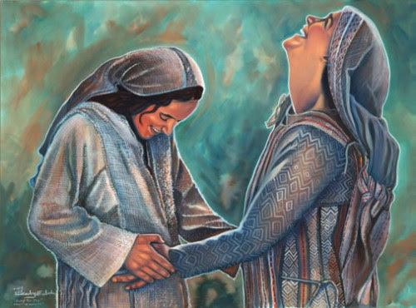

Slide 12
III. Despite being confused and disturbed, Mary trusted God and His word (verses 34-38)
38 And Mary said, “Behold, I am the servant of the Lord; let it be to me according to your word.” And the angel departed from her.

Slide 13
IV. Be the Lord’s Humble Servant
Remember God’s grace
28 …O favored one
30 …found favor with God

Slide 14
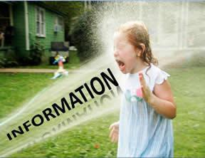
IV. Be the Lord’s Humble Servant
Remember God’s grace
Believe that God can do all things, even impossible things
“Truly, I tell you, with no one in Israel have I found such faith.” Matthew 8:10

Slide 15
IV. Be the Lord’s Humble Servant
Remember God’s grace
Believe that God can do all things, even impossible things
Rejoice over God’s grace and blessings
“My soul magnifies the Lord, and my spirit rejoices in God my Savior, for he has looked on the humble estate of his servant. For behold, from now on all generations will call me blessed; for he who is mighty has done great things for me, and holy is his name.” Luke 1:46-49

Slide 16
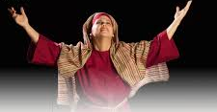
“Blessed be the God and Father of our Lord Jesus Christ, who has blessed us in Christ with every spiritual blessing in the heavenly places.” Ephesians 1:3
“In him you also, when you heard the word of truth, the gospel of your salvation, and believed in him, were sealed with the promised Holy Spirit, who is the guarantee of our inheritance until we acquire possession of it, to the praise of his glory.” Ephesians 1:13-14

Slide 17
IV. Be the Lord’s Humble Servant
Remember God’s grace
Believe that God can do all things, even impossible things
Rejoice over God’s grace and blessings
“Behold, this child is appointed for the fall and rising of many in Israel, and for a sign that is opposed (and a sword will pierce through your own soul also)” Luke 2:34-35

Slide 18
IV. Be the Lord’s Humble Servant
Remember God’s grace
Believe that God can do all things, even impossible things
Rejoice over God’s grace and blessings
Be content in all things
Knowing “that for those who love God all things work together for good, for those who are called according to his purpose.” Romans 8:28

