Slide 1
Scripture Reading
1st Thessalonians 4:13-18
Pages 1173-74 in the seat back bibles

Slide 2
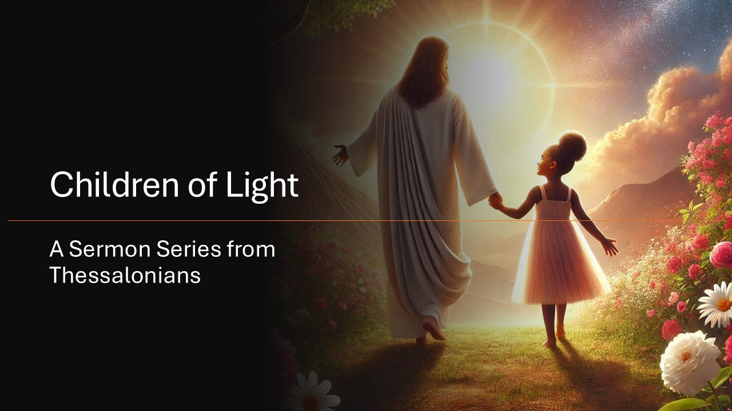

Slide 3
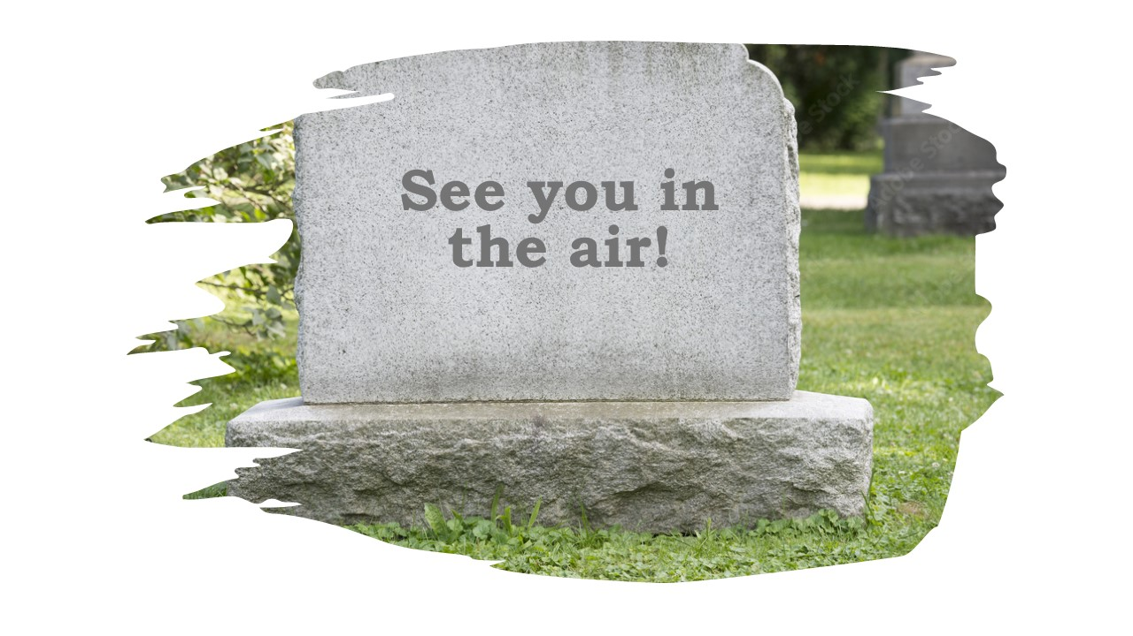
The Hope and Comfort of Resurrection
1st Thessalonians 4:13-18

Slide 4
I. The promise of our resurrection enables us to grieve with certain hope (verses 13-16)
13 But we do not want you to be uninformed, brothers, about those who are asleep, that you may not grieve as others do who have no hope.

Slide 5
I. The promise of our resurrection enables us to grieve with certain hope (verses 13-16)
13 But we do not want you to be uninformed, brothers, about those who are asleep, that you may not grieve as others do who have no hope.
Our grieving must proclaim the gospel rather than practically denying it by the way we grieve.

Slide 6
I. The promise of our resurrection enables us to grieve with certain hope (verses 13-16)
14 For since we believe that Jesus died and rose again, even so, through Jesus, God will bring with him those who have fallen asleep.

Slide 7
I. The promise of our resurrection enables us to grieve with certain hope (verses 13-16)
14 For since we believe that Jesus died and rose again, even so, through Jesus, God will bring with him those who have fallen asleep.
When Jesus returns, He will raise the dead body of the believer back to life from whatever state of decay it has experienced, reuniting the believer’s perfected spirit with his or her perfected body, now together once again as one whole person, free forever from the power and presence of sin and any possibility of death.

Slide 8
I. The promise of our resurrection enables us to grieve with certain hope (verses 13-16)
14 For since we believe that Jesus died and rose again, even so, through Jesus, God will bring with him those who have fallen asleep.
“In my Father’s house are many rooms. If it were not so, would I have told you that I go to prepare a place for you? And if I go and prepare a place for you, I will come again and will take you to myself, that where I am you may be also.” John 14:2-3

Slide 9
I. The promise of our resurrection enables us to grieve with certain hope (verses 13-16)
15 For this we declare to you by a word from the Lord, that we who are alive, who are left until the coming of the Lord, will not precede those who have fallen asleep. 16 For the Lord himself will descend from heaven with a cry of command, with the voice of an archangel, and with the sound of the trumpet of God. And the dead in Christ will rise first.
15 …will by no means precede those who are ﻿asleep.” NKJV

Slide 10
I. The promise of our resurrection enables us to grieve with certain hope (verses 13-16)
15 For this we declare to you by a word from the Lord, that we who are alive, who are left until the coming of the Lord, will not precede those who have fallen asleep. 16 For the Lord himself will descend from heaven with a cry of command, with the voice of an archangel, and with the sound of the trumpet of God. And the dead in Christ will rise first.
“He cried out with a loud voice, ‘Lazarus, come out!’” John 11:43

Slide 11
I. The promise of our resurrection enables us to grieve with certain hope (verses 13-16)
“With the resurrection of the dead…What is sown is perishable; what is raised is imperishable. It is sown in dishonor; it is raised in glory. It is sown in weakness; it is raised in power. It is sown a natural body; it is raised a spiritual body.” 1st Corinthians 15:42-44

Slide 12
I. The promise of our resurrection enables us to grieve with certain hope (verses 13-16)
“We shall all be changed, in a moment, in the twinkling of an eye, at the last trumpet. For the trumpet will sound, and the dead will be raised imperishable, and we shall be changed. For this perishable body must put on the imperishable, and this mortal body must put on immortality. When the perishable puts on the imperishable, and the mortal puts on immortality, then shall come to pass the saying that is written: ‘Death is swallowed up in victory.’ ‘O death, where is your victory? O death, where is your sting?’” 1st Corinthians 15:51-55
13 But we do not want you to be uninformed, brothers, about those who are asleep, that you may not grieve as others do who have no hope.

Slide 13
II. The promise of our resurrection enables us to live with certain hope (verse 17)
17 Then we who are alive, who are left, will be caught up together with them in the clouds to meet the Lord in the air, and so we will always be with the Lord.
“My desire is to depart and be with Christ, for that is far better.” Philippians 1:23
“Behold! I tell you a mystery. We shall not all sleep, but we shall all be changed.” 1st Corinthians 15:51
“We will not all die, but we will all be transformed!” NLT

Slide 14
II. The promise of our resurrection enables us to live with certain hope (verse 17)
17 Then we who are alive, who are left, will be caught up together with them in the clouds to meet the Lord in the air, and so we will always be with the Lord.
“Blessed be the God and Father of our Lord Jesus Christ! According to his great mercy, he has caused us to be born again to a living hope through the resurrection of Jesus Christ from the dead, to an inheritance that is imperishable, undefiled, and unfading, kept in heaven for you, who by God’s power are being guarded through faith for a salvation ready to be revealed in the last time.” 1st Peter 1:3-5

Slide 15
II. The promise of our resurrection enables us to live with certain hope (verse 17)
17 Then we who are alive, who are left, will be caught up together with them in the clouds to meet the Lord in the air, and so we will always be with the Lord.
“Blessed be the God and Father of our Lord Jesus Christ! According to his great mercy, he has caused us to be born again to a living hope through the resurrection of Jesus Christ from the dead, to an inheritance that is imperishable, undefiled, and unfading, kept in heaven for you, who by God’s power are being guarded through faith for a salvation ready to be revealed in the last time.” 1st Peter 1:3-5
“Your life is hidden with Christ in God.” Colossians 3:3

Slide 16
III. We must give comfort and encouragement to one another in our resurrection hope (verse 18)
18 Therefore encourage* one another with these words.
* Comfort
“No matter how busy we are, how pressing our problems, how overwhelming our circumstances, a day is coming when Christ shall return. That certain future gives courage and strength for today.” HNTC

Slide 17
III. We must give comfort and encouragement to one another in our resurrection hope (verse 18)
18 Therefore encourage* one another with these words.
* Comfort
When we are grieving loss, the promise of our resurrection is a truth we can always share as a comfort to one another, not to escape grieving but to set grieving on it’s healing and restoring course.
Grieve in the way where hope enables your grief to be an open door for God to move purposefully in and through your grief.

Slide 18
III. We must give comfort and encouragement to one another in our resurrection hope (verse 18)
18 Therefore encourage* one another with these words.
* Comfort
“Brothers, we ask and urge you in the Lord Jesus, that as you received from us how you ought to walk and to please God” 4:1
“And let us consider how to stir up one another to love and good works, not neglecting to meet together, as is the habit of some, but encouraging one another, and all the more as you see the Day drawing near.” Hebrews 10:24-25

Slide 19
Closing Thoughts & Benediction

