Slide 1
Scripture Reading
1st Thessalonians 5:1-11
Page 1174 in the seat back bibles

Slide 2
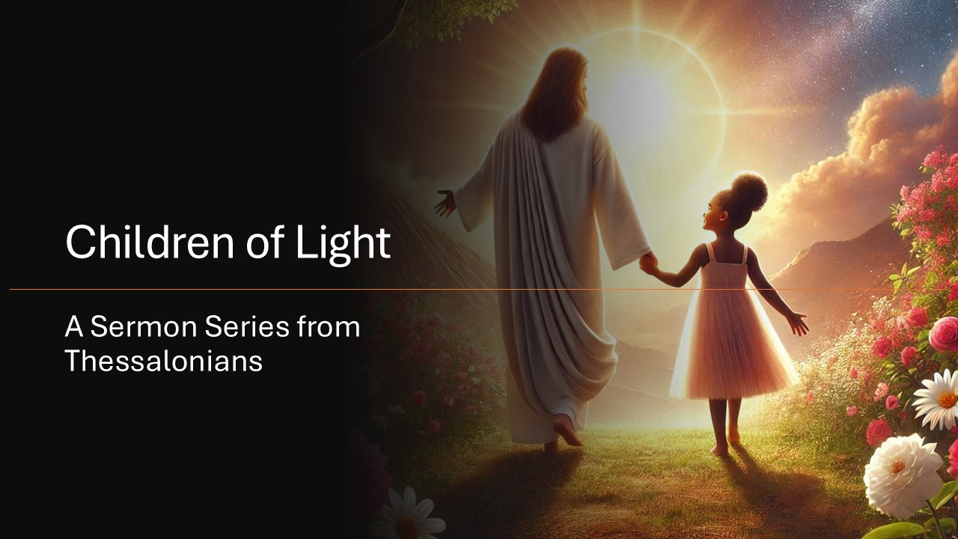

Slide 3
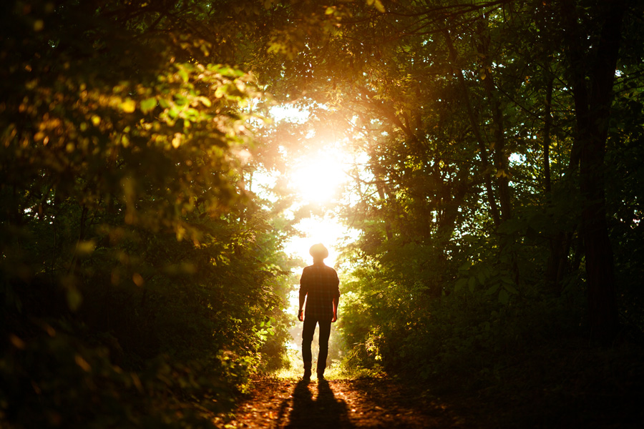
Be Children of Light!
“For everyone who does wicked things hates the light and does not come to the light.” John 3:20
1st Thessalonians 5:1-11

Slide 4
I. The day of the Lord will bring sudden destruction upon the lost (verses 1-3)
1 Now concerning the times and the seasons, brothers, you have no need to have anything written to you. 2 For you yourselves are fully aware that the day of the Lord will come like a thief in the night.

Slide 5
I. The day of the Lord will bring sudden destruction upon the lost (verses 1-3)
1 Now concerning the times and the seasons, brothers, you have no need to have anything written to you. 2 For you yourselves are fully aware that the day of the Lord will come like a thief in the night.
The return of Jesus taught in chapter 4 is part of the day of the Lord
Times and seasons = a distinct timeframe and its conditions
= the day of the Lord
= The 7-year Tribulation
Therefore, Jesus’ return is one of the conditions that will occur as part of the Tribulation

Slide 6
I. The day of the Lord will bring sudden destruction upon the lost (verses 1-3)
1 Now concerning the times and the seasons, brothers, you have no need to have anything written to you. 2 For you yourselves are fully aware that the day of the Lord will come like a thief in the night.
The Thessalonians understood how Christ’s return fit into the larger timeframe of events that would come to pass in the day of the Lord.

Slide 7
I. The day of the Lord will bring sudden destruction upon the lost (verses 1-3)
3 While people are saying, “There is peace and security,” then sudden destruction will come upon them as labor pains come upon a pregnant woman, and they will not escape.
“And he shall make a strong covenant with many for one week.” Daniel 9:27

Slide 8
I. The day of the Lord will bring sudden destruction upon the lost (verses 1-3)
3 While people are saying, “There is peace and security,” then sudden destruction will come upon them as labor pains come upon a pregnant woman, and they will not escape.
“And he shall make a strong covenant with many for one week.” Daniel 9:27

Slide 9
II. Children of light will not share the destiny of the lost (verses 4-5, 9)
4 But you are not in darkness, brothers, for that day to surprise you like a thief. 5 For you are all children of light, children of the day. We are not of the night or of the darkness.
9 For God has not destined us for wrath, but to obtain salvation through our Lord Jesus Christ.
“For He rescued us from the domain of darkness, and transferred us to the kingdom of His beloved Son.” Colossians 1:13, NASB

Slide 10
II. Children of light will not share the destiny of the lost (verses 4-5, 9)
4 But you are not in darkness, brothers, for that day to surprise you like a thief. 5 For you are all children of light, children of the day. We are not of the night or of the darkness.
9 For God has not destined us for wrath, but to obtain salvation through our Lord Jesus Christ.
“For He rescued us from the domain of darkness, and transferred us to the kingdom of His beloved Son.” Colossians 1:13, NASB

Slide 11
III. Children of light ought to reflect what they’re destined for (verses 6-10)
6 So then let us not sleep,* as others do, but let us keep awake and be sober. 7 For those who sleep, sleep** at night, and those who get drunk, are drunk at night.
* Spiritually lethargic
** Physical sleep
“Though it is impossible for the day of the Lord to catch Christians unprepared, it is possible for them to adopt the same lifestyle as those who will be caught unawares.” Robert Thomas, commentary on verse 6

Slide 12
III. Children of light ought to reflect what they’re destined for (verses 6-10)
8 But since we belong to the day, let us be sober, having put on the breastplate of faith and love, and for a helmet the hope of salvation.
“You are not your own, for you were bought with a price. So glorify God in your body.” 1st Corinthians 6:19-20
“If we find ourselves with a desire that nothing in this world can satisfy, the most probable explanation is that we were made for another world.” C.S. Lewis

Slide 13
III. Children of light ought to reflect what they’re destined for (verses 6-10)
9 For God has not destined us for wrath, but to obtain salvation through our Lord Jesus Christ, 10 who died for us so that whether we are awake or asleep we might live with him.
1) He has died the death our sins deserved so that He can freely give us the eternal life we don’t deserve.
2) He has suffered God’s judgment of wrath against us in our place so that we will never have to experience it.
Those who do not trust in Christ are destined for a death leading to an eternity of God’s wrath.

Slide 14
III. Children of light ought to reflect what they’re destined for (verses 6-10)
9 For God has not destined us for wrath, but to obtain salvation through our Lord Jesus Christ, 10 who died for us so that whether we are awake or asleep we might live with him.
The day of the Lord is coming; a time when “the heavens and earth that now exist are stored up for fire, being kept until the day of judgment and destruction of the ungodly.” 2nd Peter 3:7
God has proven that He protects His people from His wrath in a diversity of ways, and any of those ways may prove to be how he protects us from His wrath in the coming day of the Lord.

Slide 15
IV. Be children of light! (verse 11)
“We should not be like Cain, who was of the evil one and murdered his brother. And why did he murder him? Because his own deeds were evil and his brother’s righteous. Do not be surprised, brothers, that the world hates you.” 1st John 3:12-13
A great paradox of the mission of the church is that we’re commanded to go to the world with the gospel, an offensive message that the world hates about the need for a Savior that the world hates being delivered by Christians that the world hates because they’re children of light.

Slide 16
IV. Be children of light! (verse 11)
Scripture doesn’t teach us to pursue peace at all costs. It teaches “If possible, so far as it depends on you, live peaceably with all” (Romans 12:18), mindful of the fact that our Lord and King teaches us “Do not think that I have come to bring peace to the earth. I have not come to bring peace, but a sword. For I have come to set a man against his father, and a daughter against her mother, and a daughter-in-law against her mother-in-law. And a person’s enemies will be those of his own household” (Matthew 10:34-36).

Slide 17
IV. Be children of light! (verse 11)
11 Therefore encourage one another and build one another up, just as you are doing.
“Because you have kept my word about patient endurance, I will keep you from the hour of trial that is coming on the whole world, to try those who dwell on the earth.” Revelation 3:10

Slide 18
Closing Thoughts & Benediction

