Slide 1
Scripture Reading
1st Thessalonians 5:12-28
Page 1174 in the seat back bibles

Slide 3
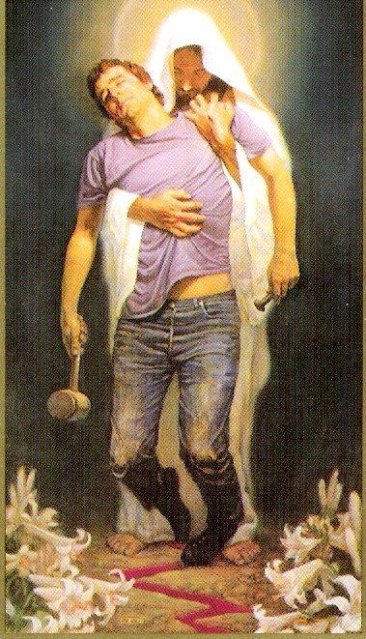
It’s All Grace!
God’s amazing grace is at work in our lives today, “training us to renounce ungodliness and worldly passions, and to live self-controlled, upright, and godly lives in the present age.” Titus 2:12
1st Thessalonians 5:12-28

Slide 4
I. Respect and esteem the leaders in the church (verses 12-13)
12 We ask you, brothers, to respect those who labor* among you and are over you in the Lord and admonish** you, 13 and to esteem them very highly in love because of their work. Be at peace among yourselves.
* Work to the point of exhaustion
** Correct wrong conduct
“Obey your leaders and submit to them, for they are keeping watch over your souls, as those who will have to give an account. Let them do this with joy and not with groaning, for that would be of no advantage to you.” Hebrews 13:17

Slide 5
II. Work together to grow together in ways that are good (verses 14-15)
14 And we urge you, brothers, admonish the idle, encourage the fainthearted, help the weak, be patient with them all. 15 See that no one repays anyone evil for evil, but always seek to do good to one another and to everyone.
The entire congregation, not just the leaders, are commanded to engage in the routine church discipline of correcting one another back to the way of Jesus.

Slide 6
II. Work together to grow together in ways that are good (verses 14-15)
14 And we urge you, brothers, admonish the idle, encourage the fainthearted, help the weak, be patient with them all. 15 See that no one repays anyone evil for evil, but always seek to do good to one another and to everyone.
I believe some level of encouragement, one to another, is always necessary.

Slide 7
II. Work together to grow together in ways that are good (verses 14-15)
14 And we urge you, brothers, admonish the idle, encourage the fainthearted, help the weak, be patient with them all. 15 See that no one repays anyone evil for evil, but always seek to do good to one another and to everyone.
“Perhaps they lack knowledge or experience; it could be that they struggle with certain sins which continually defeat them; they may lack courage or find it difficult to trust God. They are weak in the faith and need to be helped along the way.” Knute Larson, HNTC

Slide 8
II. Work together to grow together in ways that are good (verses 14-15)
14 And we urge you, brothers, admonish the idle, encourage the fainthearted, help the weak, be patient with them all. 15 See that no one repays anyone evil for evil, but always seek to do good to one another and to everyone.
“No faster than grace”
“It’s all grace”

Slide 9
II. Work together to grow together in ways that are good (verses 14-15)
14 And we urge you, brothers, admonish the idle, encourage the fainthearted, help the weak, be patient with them all. 15 See that no one repays anyone evil for evil, but always seek to do good to one another and to everyone.
“You have heard that it was said, ‘An eye for an eye and a tooth for a tooth.’ But I say to you, Do not resist the one who is evil.” Matthew 5:38-39
In Christ, acting for the good of the offender (to challenge his or her conscience by a Christlike response) is the good the offender needs.

Slide 10
III. Be inwardly renewed day by day (verses 16-18)
“So we do not lose heart. Though our outer self is wasting away, our inner self is being renewed day by day.” 2nd Corinthians 4:16
16 Rejoice always, 17 pray without ceasing, 18 give thanks in all circumstances; for this is the will of God in Christ Jesus for you.
Joy is appropriate in our relatively light present circumstances because there is “an eternal weight of glory beyond all comparison” (2nd Corinthians 4:17) that awaits us because of the weight of affliction we bear now.

Slide 11
III. Be inwardly renewed day by day (verses 16-18)
“So we do not lose heart. Though our outer self is wasting away, our inner self is being renewed day by day.” 2nd Corinthians 4:16
16 Rejoice always, 17 pray without ceasing, 18 give thanks in all circumstances; for this is the will of God in Christ Jesus for you.

Slide 12
III. Be inwardly renewed day by day (verses 16-18)
“So we do not lose heart. Though our outer self is wasting away, our inner self is being renewed day by day.” 2nd Corinthians 4:16
16 Rejoice always, 17 pray without ceasing, 18 give thanks in all circumstances; for this is the will of God in Christ Jesus for you.
When we live in this way of close communion with God because our inner person is growing to be more like His Son, then we can come before Him “as a living sacrifice, holy and acceptable to” Him as Paul teaches in Romans 12:1.

Slide 13
IV. Worship the Lord in spirit and truth (verses 19-22)
19 Do not quench the Spirit. 20 Do not despise prophecies, 21 but test everything; hold fast what is good. 22 Abstain from every form of evil.
Spiritual gifts are for the common good and should be practiced out of love for one another, but when we fail to see them in this way, we quench the Spirit’s aim to bring about the good He has intended through them.

Slide 14
IV. Worship the Lord in spirit and truth (verses 19-22)
19 Do not quench the Spirit. 20 Do not despise prophecies,* 21 but test everything; hold fast what is good. 22 Abstain from every form of evil.
* The gift of interpreting divine will or purpose
“Let two or three prophets speak, and let the others weigh what is said. If a revelation is made to another sitting there, let the first be silent. For you can all prophesy one by one, so that all may learn and all be encouraged, and the spirits of prophets are subject to prophets. For God is not a God of confusion but of peace.” 1st Corinthians 14:29-33

Slide 15
IV. Worship the Lord in spirit and truth (verses 19-22)
19 Do not quench the Spirit. 20 Do not despise prophecies, 21 but test everything; hold fast what is good. 22 Abstain from every form of evil.
“True worshipers will worship the Father in spirit and truth, for the Father is seeking such people to worship him.” John 4:23
His work in our worship must not be quenched, but our worship must be tested to confirm what is the work of the Spirit and what is not by whether or not our worship is weighed and tested as good according to the truth of God’s word.

Slide 16
V. It’s all grace! (verses 23-28)
23 Now may the God of peace himself sanctify you completely, and may your whole spirit and soul and body be kept blameless at the coming of our Lord Jesus Christ. 24 He who calls you is faithful; he will surely do it. 25 Brothers, pray for us. 26 Greet all the brothers with a holy kiss. 27 I put you under oath before the Lord to have this letter read to all the brothers. 28 The grace of our Lord Jesus Christ be with you.
Unlike those with the gift of prophesy, Paul’s words were not to be weighed and tested. The Lord had already affirmed Paul’s words as the Lord’s own word. Paul’s writings are God’s word, and we must take them as such.

Slide 17
V. It’s all grace! (verses 23-28)
23 Now may the God of peace himself sanctify you completely, and may your whole spirit and soul and body be kept blameless at the coming of our Lord Jesus Christ. 24 He who calls you is faithful; he will surely do it.
28 The grace of our Lord Jesus Christ be with you.
We are obligated to heed every command in today’s text, but that obligation is taken by the faith that believes that God will enable every step of obedience by His grace.

Slide 18
It’s All Grace!
Always

Slide 19
Closing Thoughts & Benediction

